Slide 1
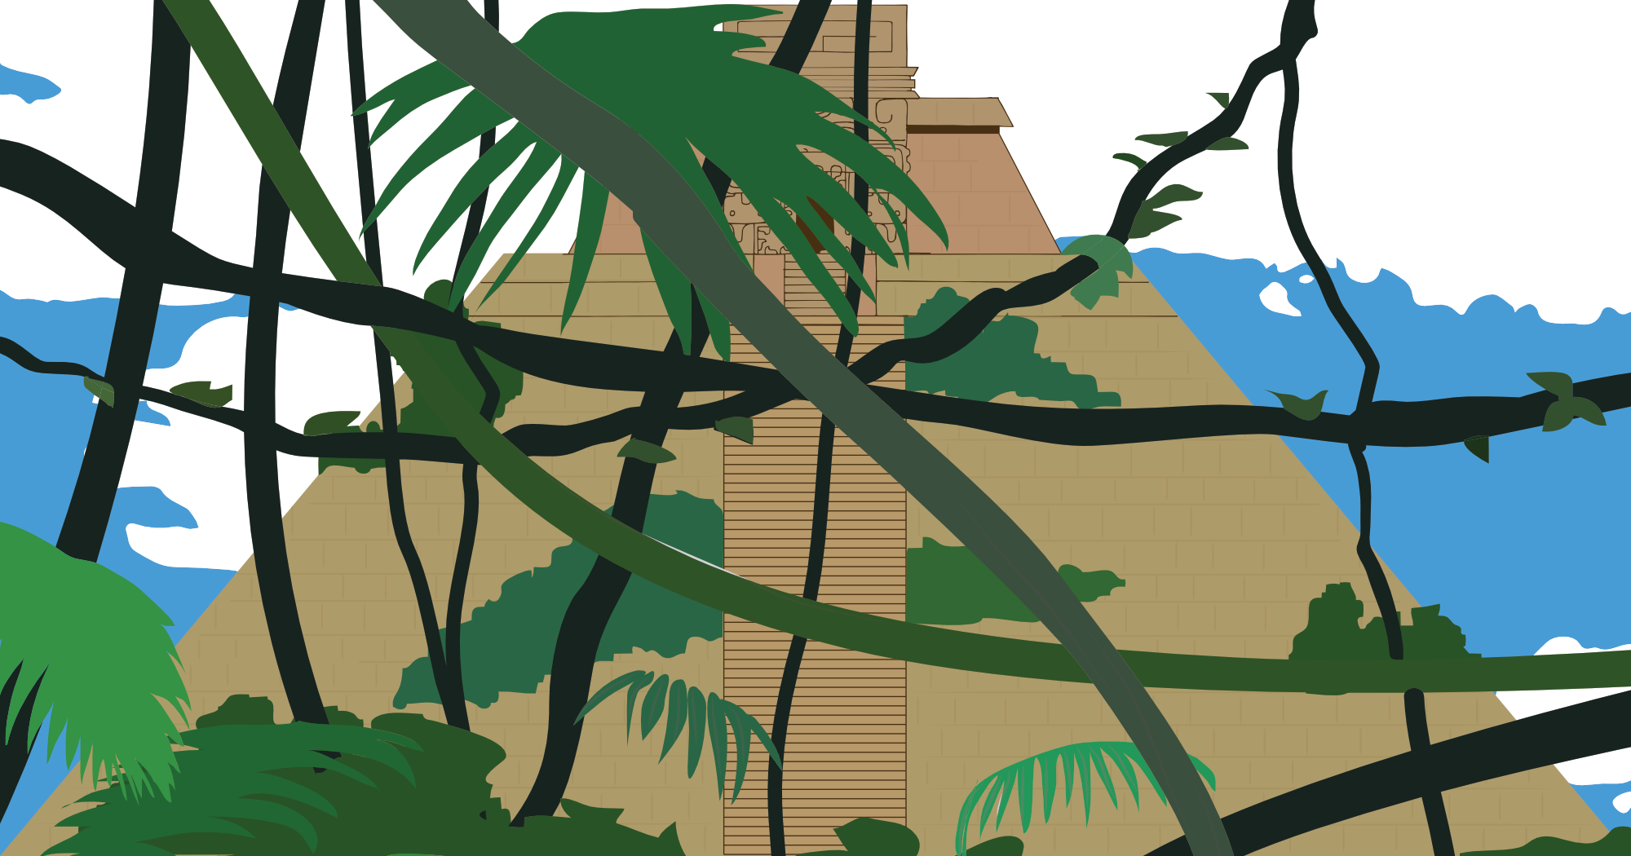
Crafting an Adventure
The Making of the Azure Maya Mystery
Jen Looper & Chris Noring
@jenlooper @chris_noring

Slide 2
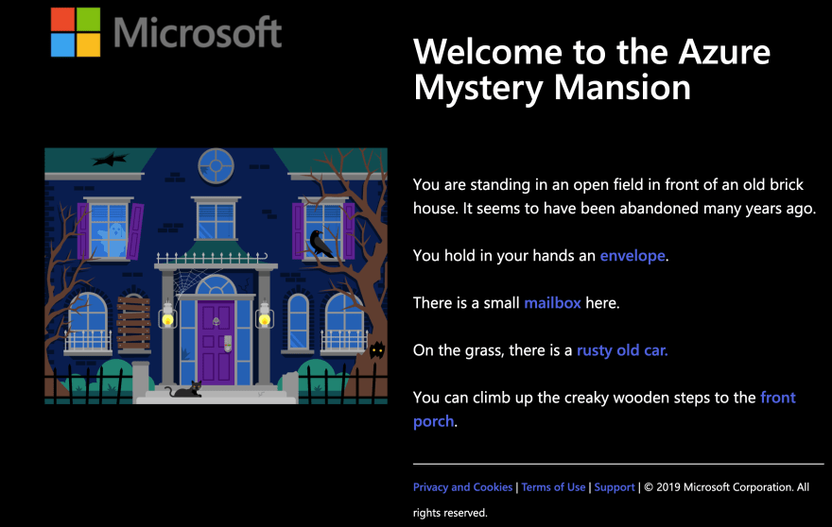
It all began with a Mansion

Slide 3
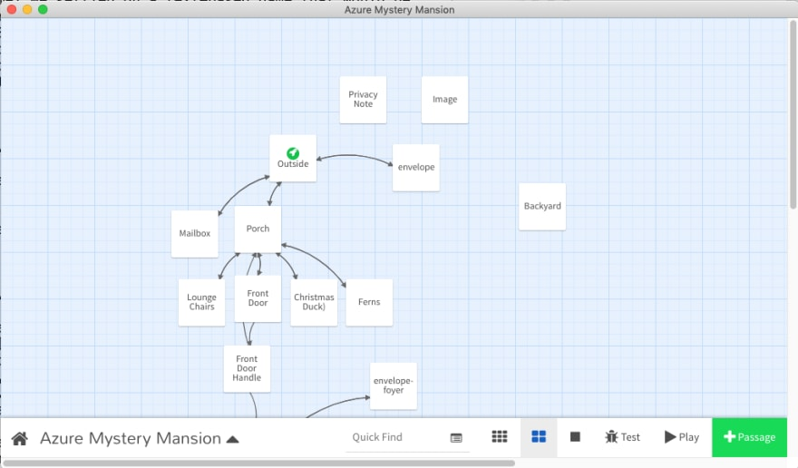
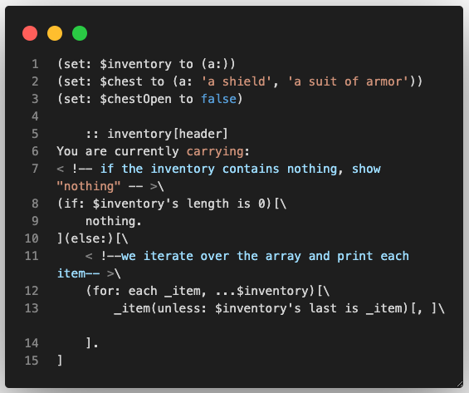
Built with Twine
Main developer: Em Lazer-Walker

Slide 4
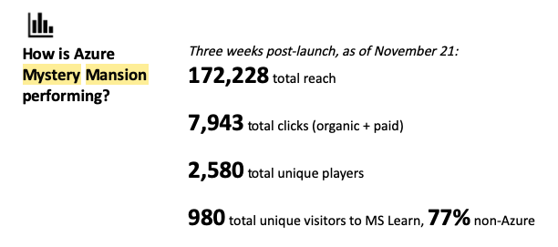
A big hit!

Slide 5
V2, what to do?
Mystery Mansion v2?
The Mysterious Outbuildings?
The Haunted Outhouse?
A regional ‘ask’ for a Mystery-type adventure
A storytelling app + code-challenge with links to Microsoft Learn and Docs
A more customizable, scalable engine
Focusing on teaching one tech stack per release via code challenges

Slide 6
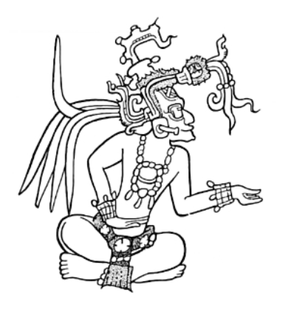
Keep the Mystery, Add some culture
Museums and Libraries pilot
Work with Maya Archive with Cal State Chico
A clear Regional storyline
A three-part-challenge
focusing on three tech stacks:
Azure Static Apps for July
Node.js for August
AI/ML for September
May I help you?

Slide 7

How to gamify culture?
Please, no

Slide 8
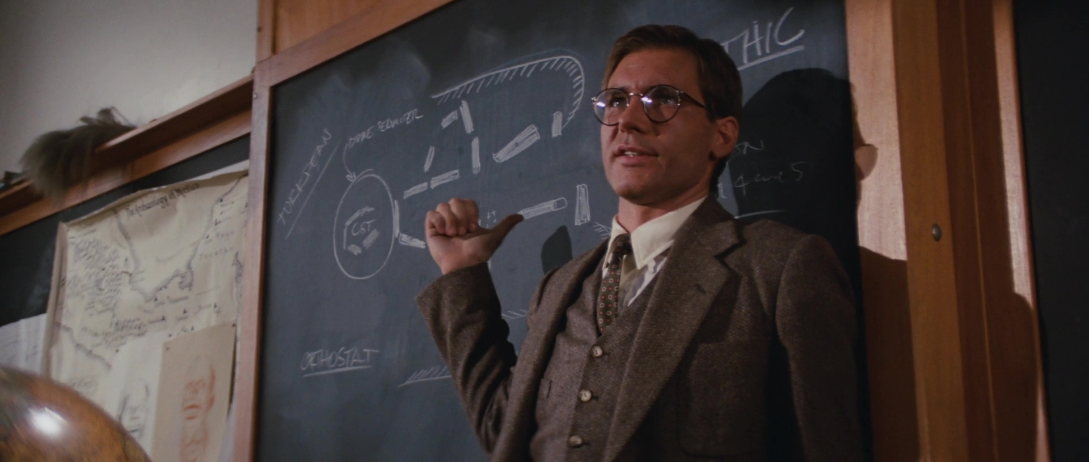
A little better!

Slide 9
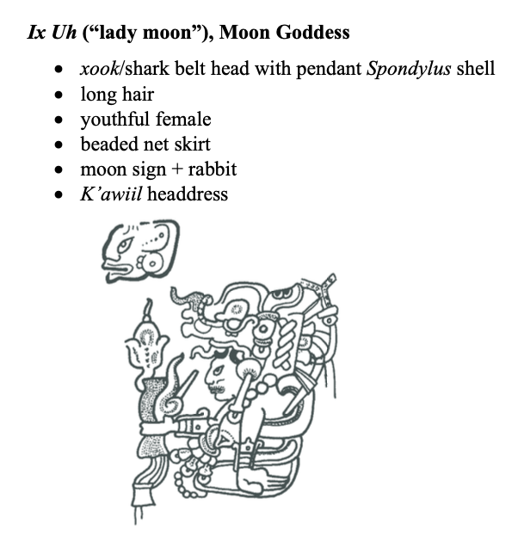
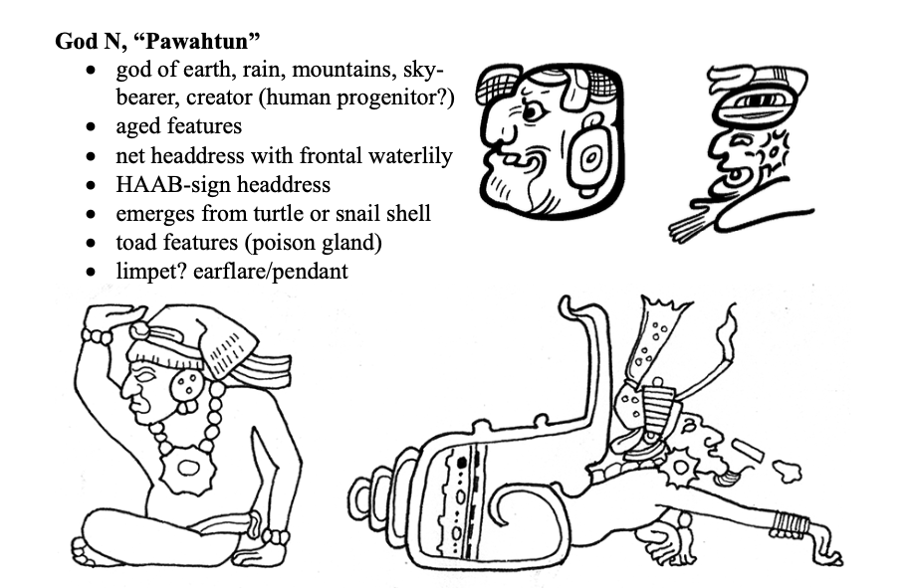
Inspired by deep culture
Rich indigenous Maya culture offers great inspiration for a storyline

Slide 10
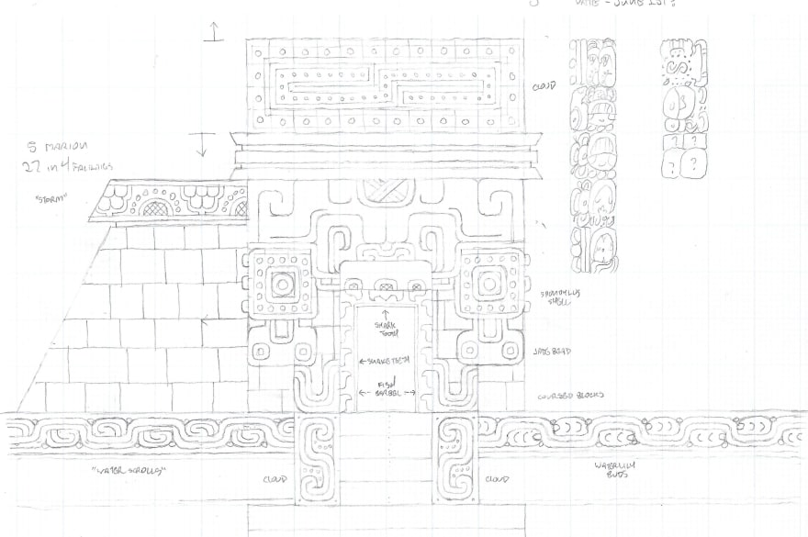
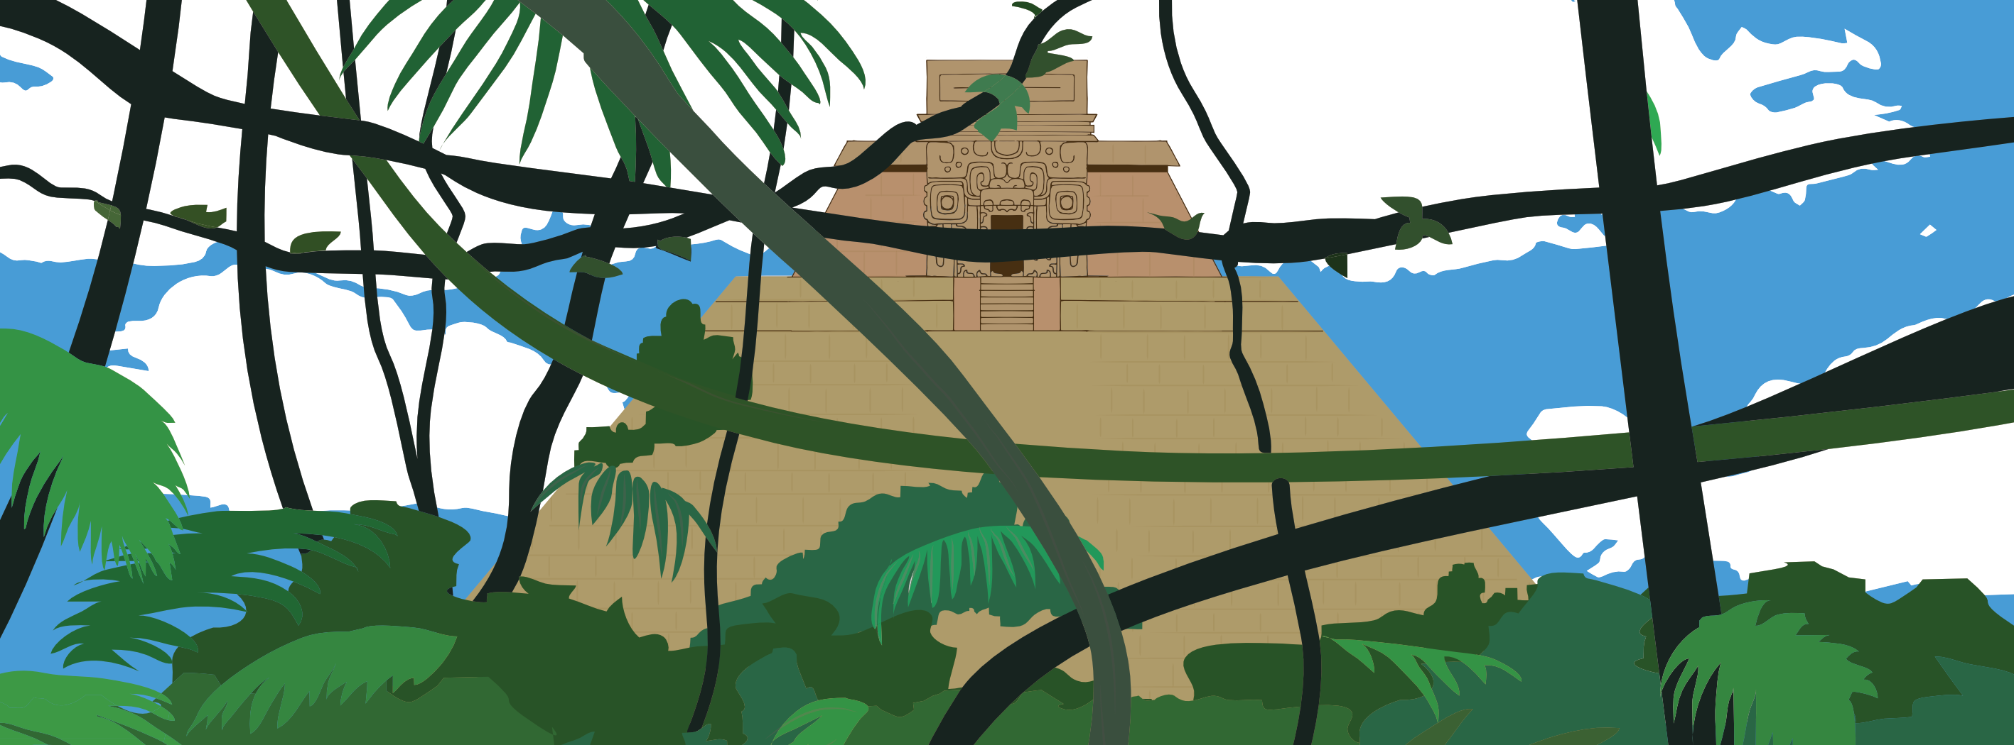
Working with an artist: Dana Moot II

Slide 11
Building a new experience
VuePress, for a more customizable dev experience
PlayFab backend
Mini embedded game elements via Vue components
Localized in 4 languages
Deployed with Azure Static Web Apps

Slide 12
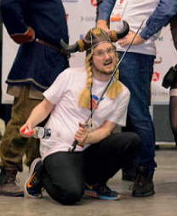
Eek! How do you build a game with VuePress?
1-800-Chris-Noring
Built a POC using
VuePress
Local Storage storing retrieved inventory items
JSON-driven storyline
Text-based instructions = easy to focus on the narrative, not the engine

Slide 13
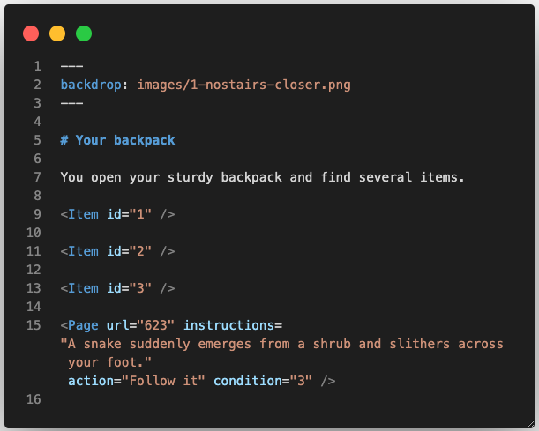
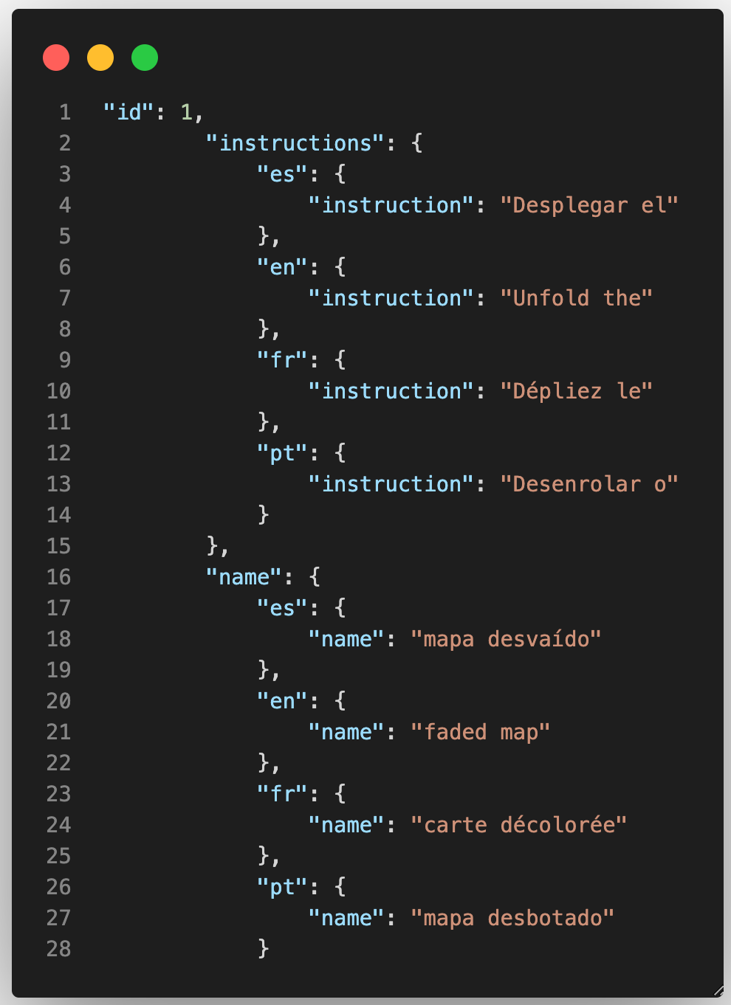
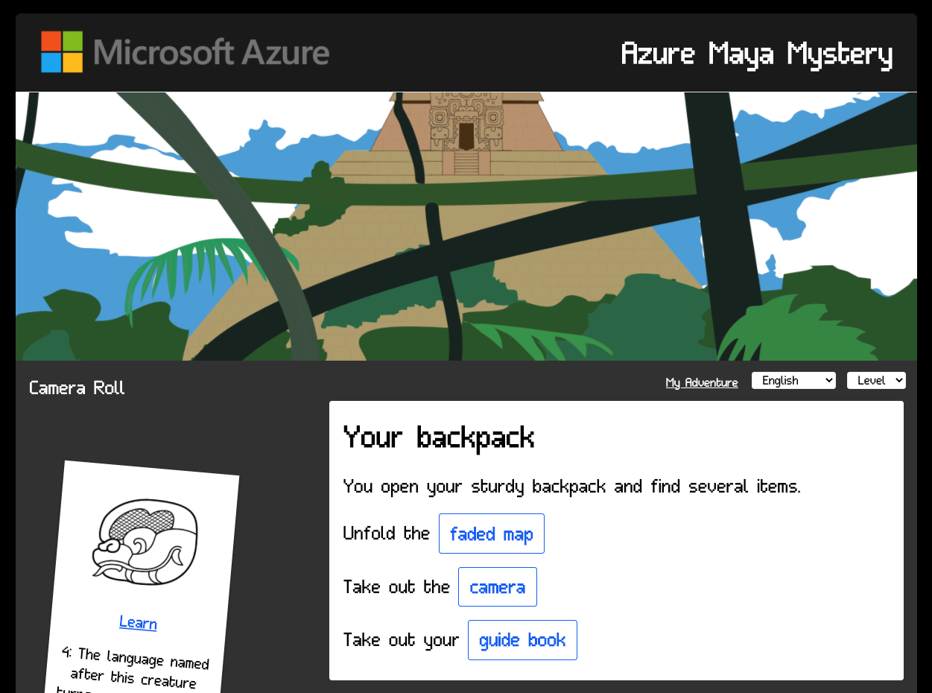
Markdown+Vue components

Slide 14
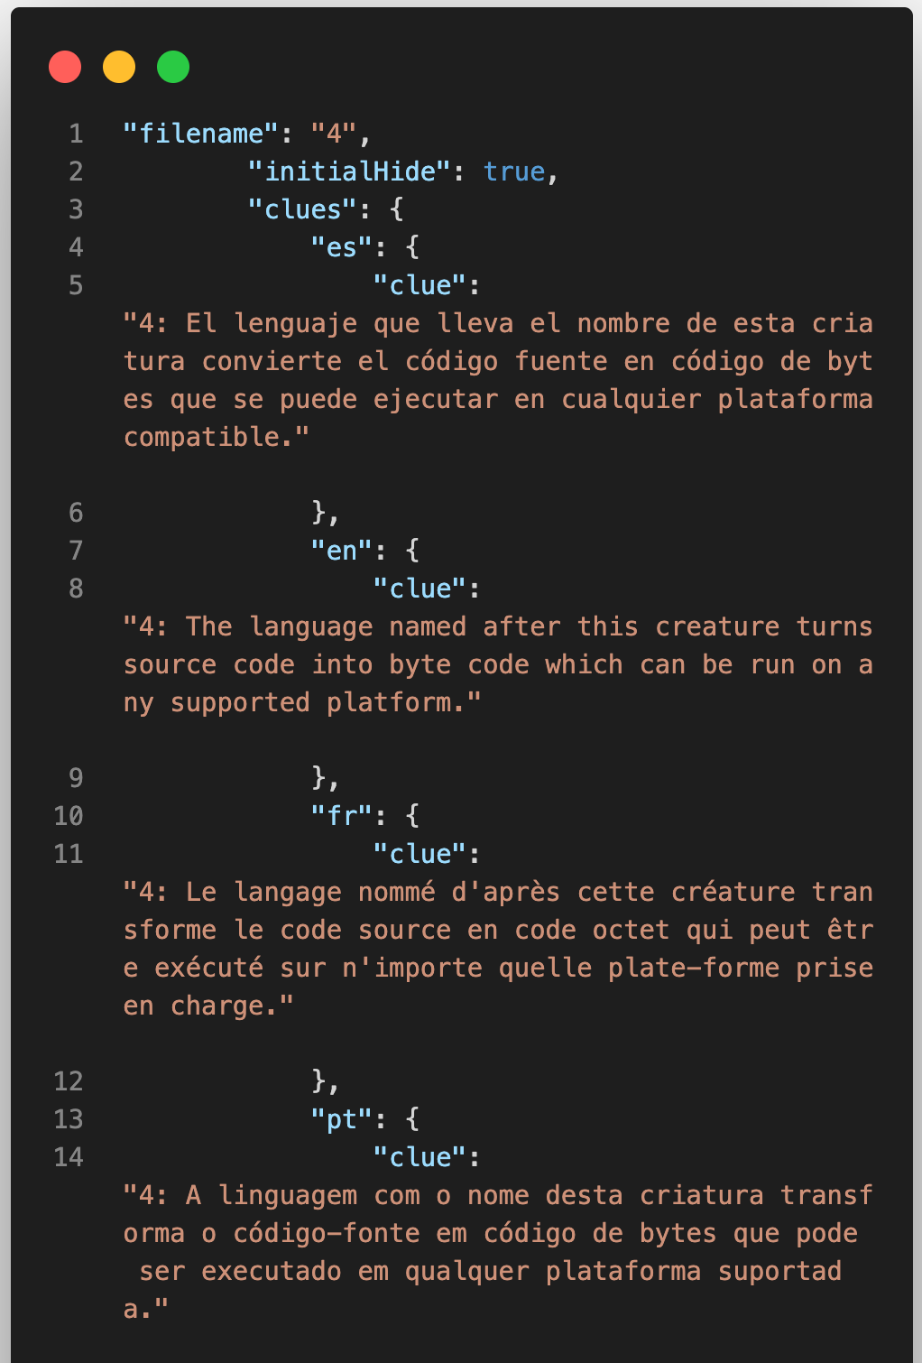
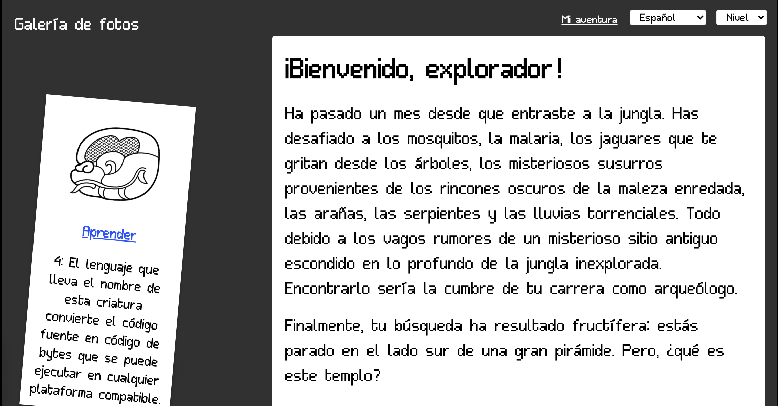
Localized story elements in JSON

Slide 15
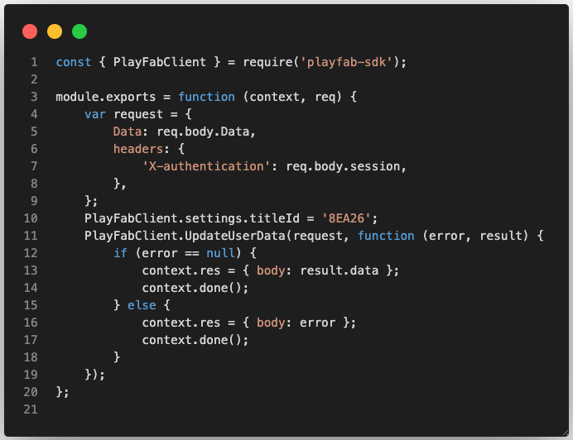
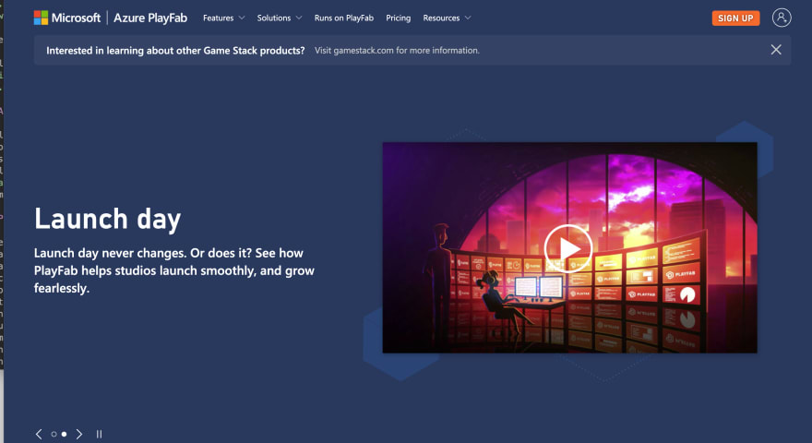
Connection to PlayFab

Slide 16
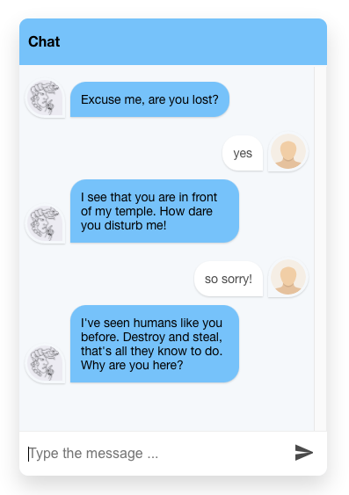
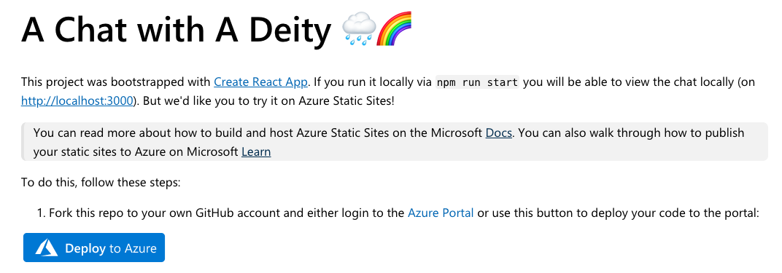
July’s challenge

Slide 17
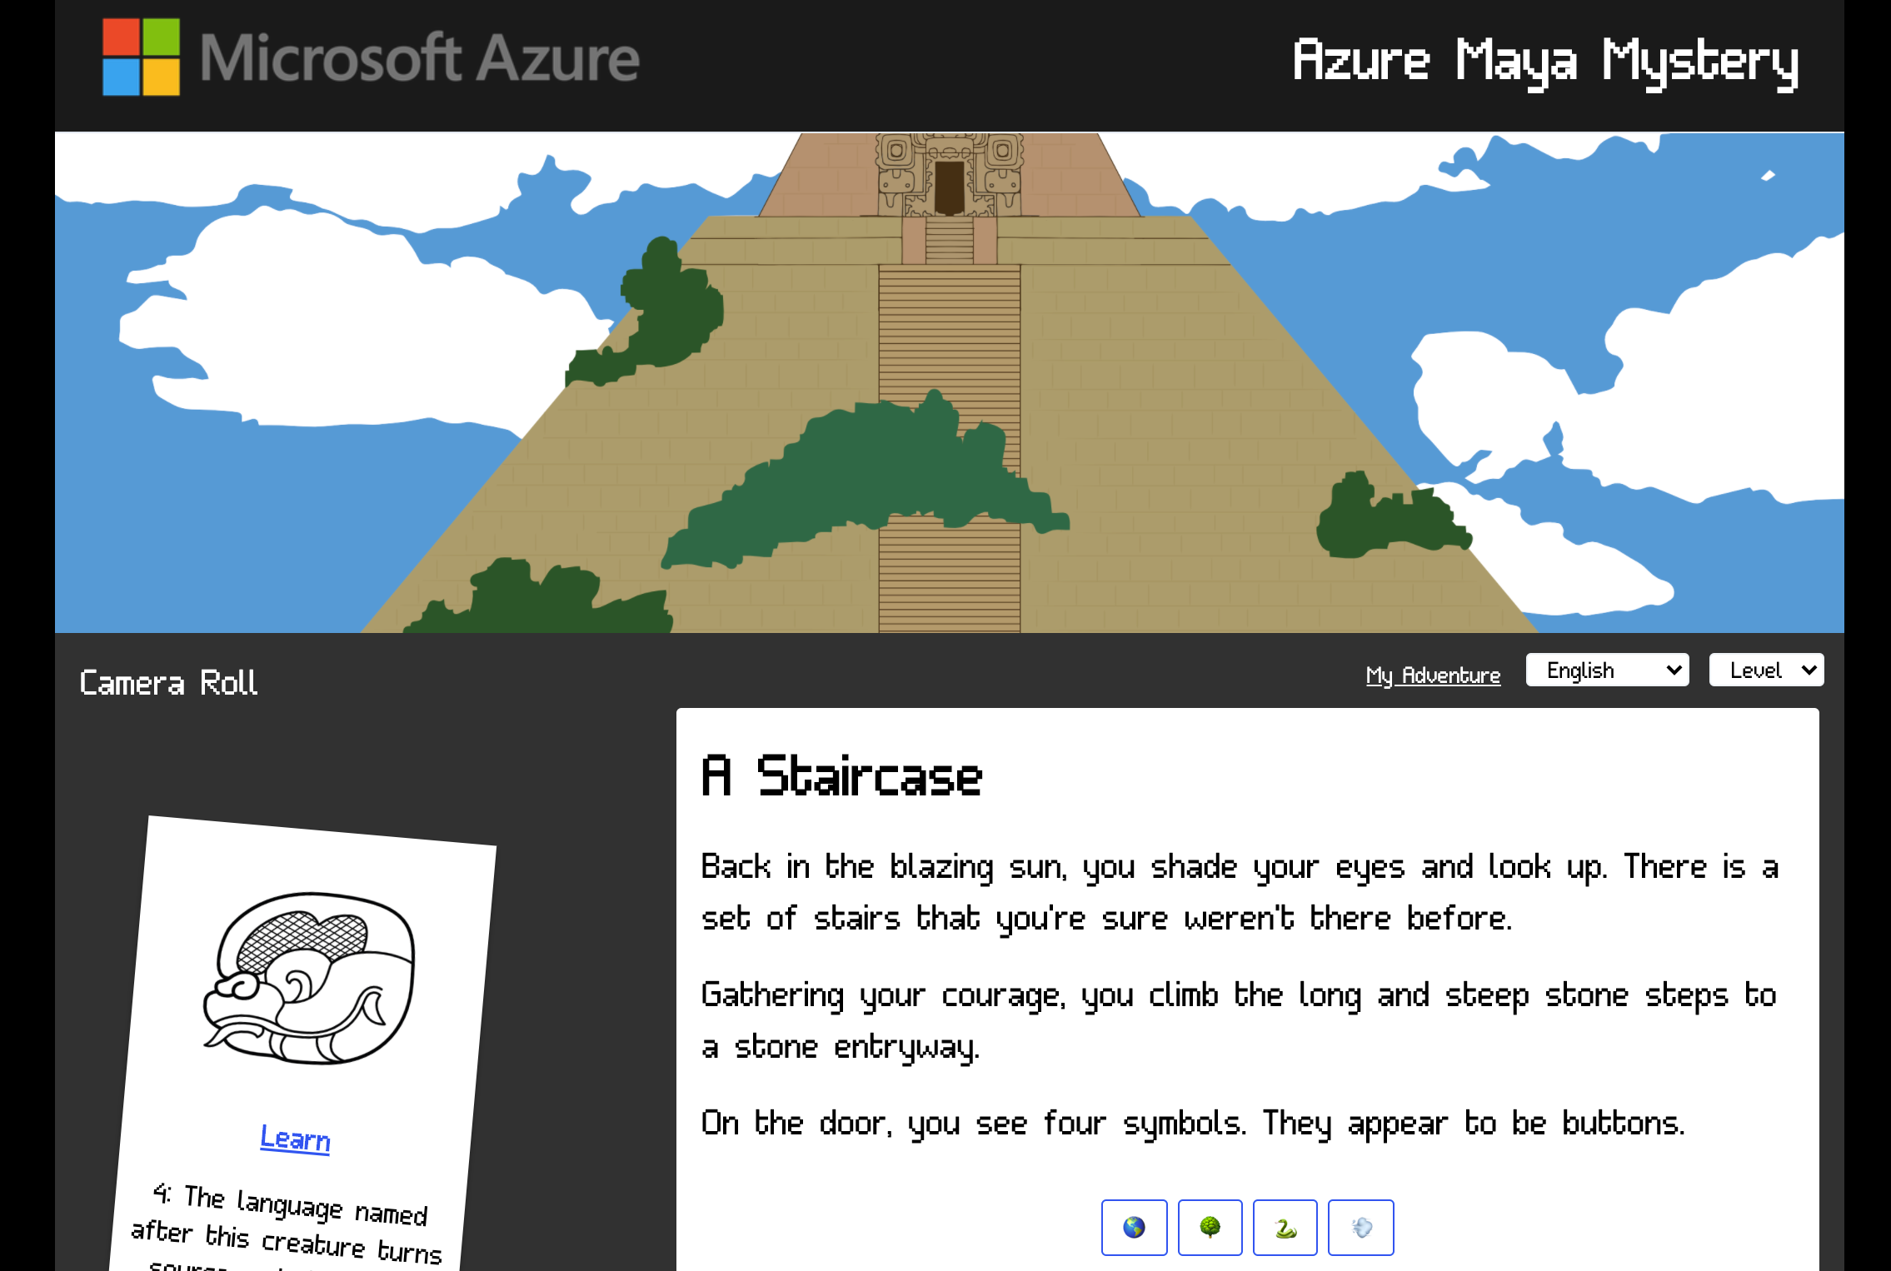
The completed interface

Slide 18
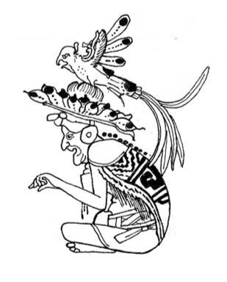

Use Static Web Apps to teach about Static Web Apps
It’s pretty magical!

Slide 19
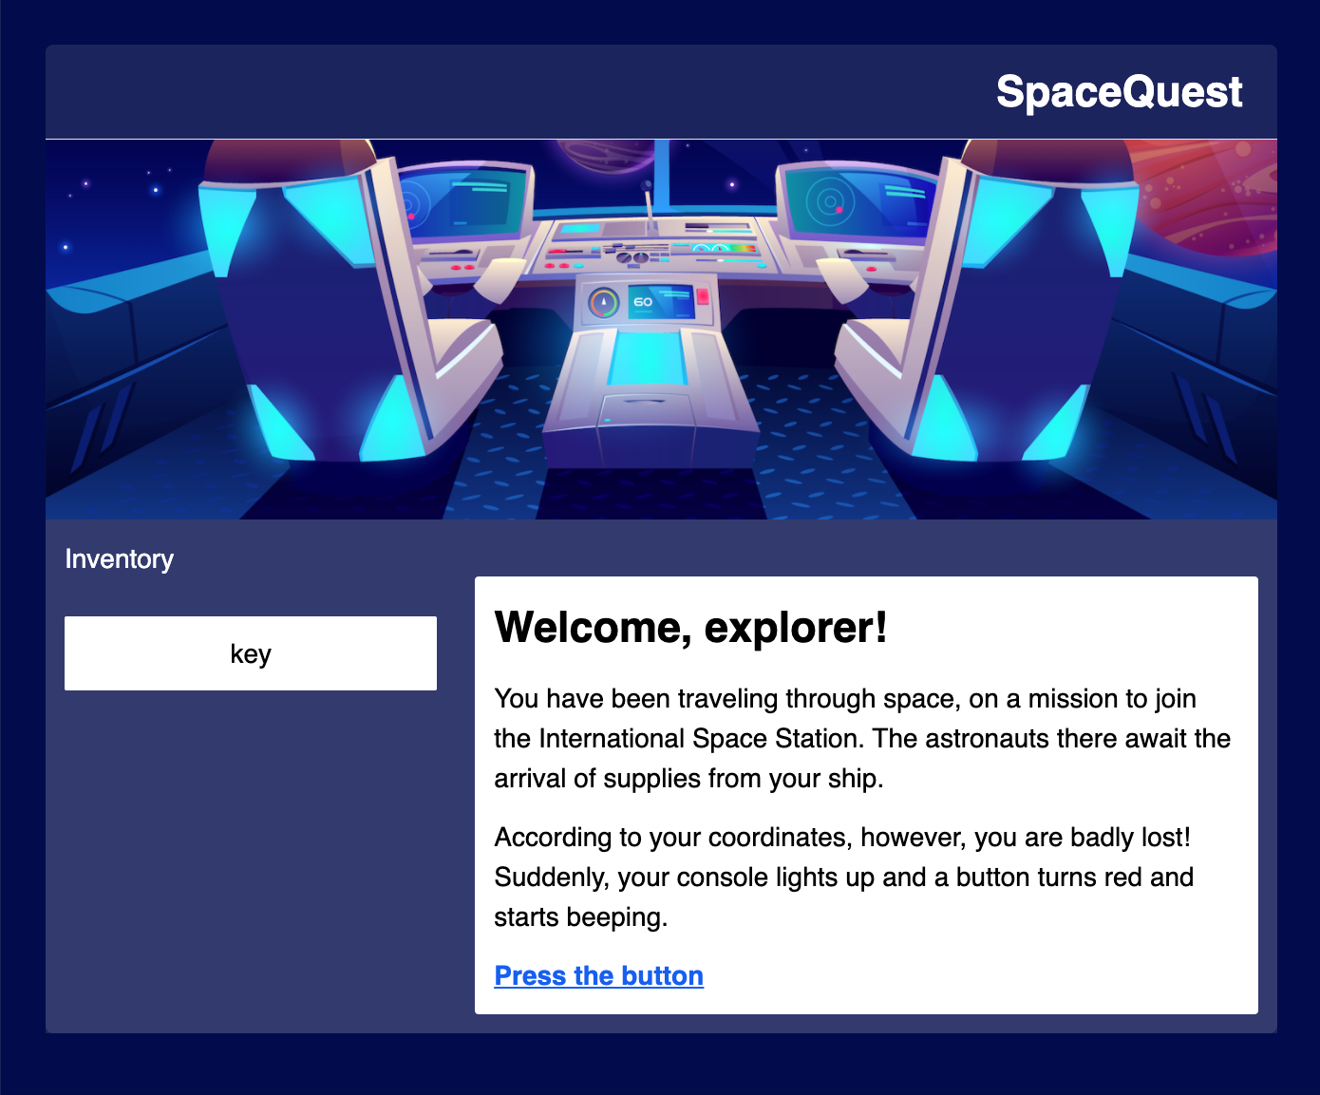
What’s next?
Magic-a—a-Service (MAAS)
Per Tommy’s request, a bespoke game engine to create your own adventures
August Launch: “The Mysterious Cenote” – learn the second part of the pyramid’s name, dive into a cenote to retrieve and reassemble glyphs, and a Node.js code challenge
September Launch: “The Summit” – solve puzzles and overcome obstacles to climb to the summit and learn the full name of the pyramid using Machine Learning
Aka.ms/game-engine

Slide 20

Come explore with us!
Aka.ms/AzureMayaMystery

Slide 21
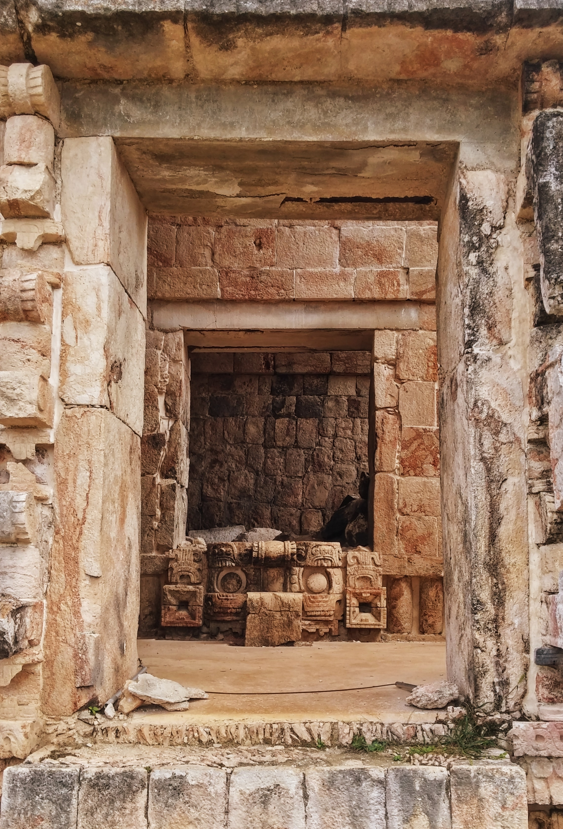
expedition leads
Development: Jen Looper @jenlooper & Chris Noring @chris_noring
Creative Director: Em Lazer-Walker
Translations: Vicente Guzmán, Tania Allard, Ricardo Prins, Samir Si-Mohammed, Max Rouiller, Jen Looper, Gustavo Cordido
Community Team: Cynthia Zanoni, Piyali Dey
Art: Dana Moot II
Cultural Consultant: Matthew Looper, Professor of Ancient Mesoamerican Art History, California State University, Chico

